Slide 1

Real-Time Weather Monitoring System with AWS IoT Core and DynamoDB
D Revanth kumar (2210030452)
Under the esteemed guidance of
Ms. P. Sree Lakshmi
Assistant Professor,
Department of Computer Science and Engineering

Slide 2
Project Overview
Access to accurate, real-time weather data is often limited, especially in remote or rural areas. Traditional systems are expensive and not scalable. There's an opportunity to create a low-cost, cloud-based IoT solution to monitor weather conditions efficiently.
To design and implement a real-time weather monitoring system using AWS IoT Core and DynamoDB that collects, transmits, and stores weather data such as temperature, humidity, and pressure for easy access and analysis.
This system can help in smart agriculture, environmental research, urban development, and disaster management by providing timely, localized weather insights to support data-driven decisions.

Slide 3



Services Used
AWS IoT Core:
Connects the weather sensors and alerts the system with real-time data. It helps detect high temperature and forwards data for storage or action.
Amazon DynamoDB:
Stores incoming weather data (like temperature, humidity, pressure) in a fast, scalable NoSQL format.
Amazon SNS:
Sends notifications (email or SMS) when temperature readings go above 35°C, helping take quick action.

Slide 4
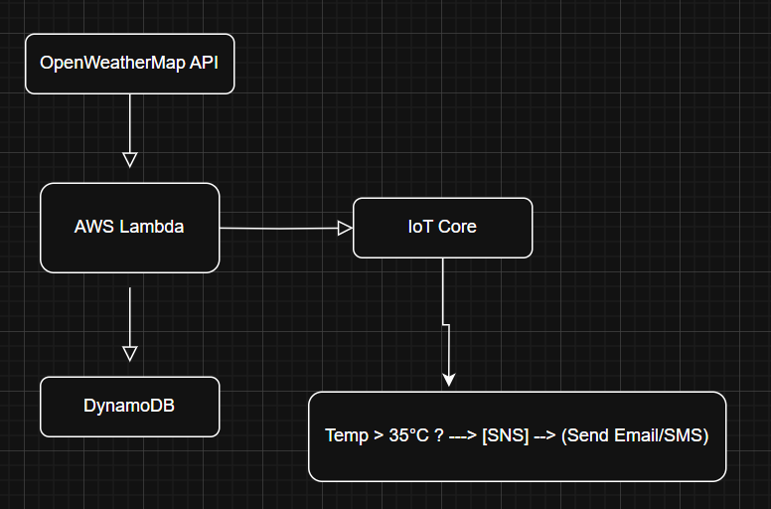
Flow Diagram
AWS Console: For setting up IoT Core, DynamoDB tables, SNS topics.
OpenWeatherMap API: External weather data source
AWS Lambda: Data fetch, processing, and routing logic
Amazon DynamoDB: Stores weather data
AWS IoT Core: Sends alerts and triggers rules for incoming data
Amazon SNS: Sends notification if temperature > 35°C

Slide 5
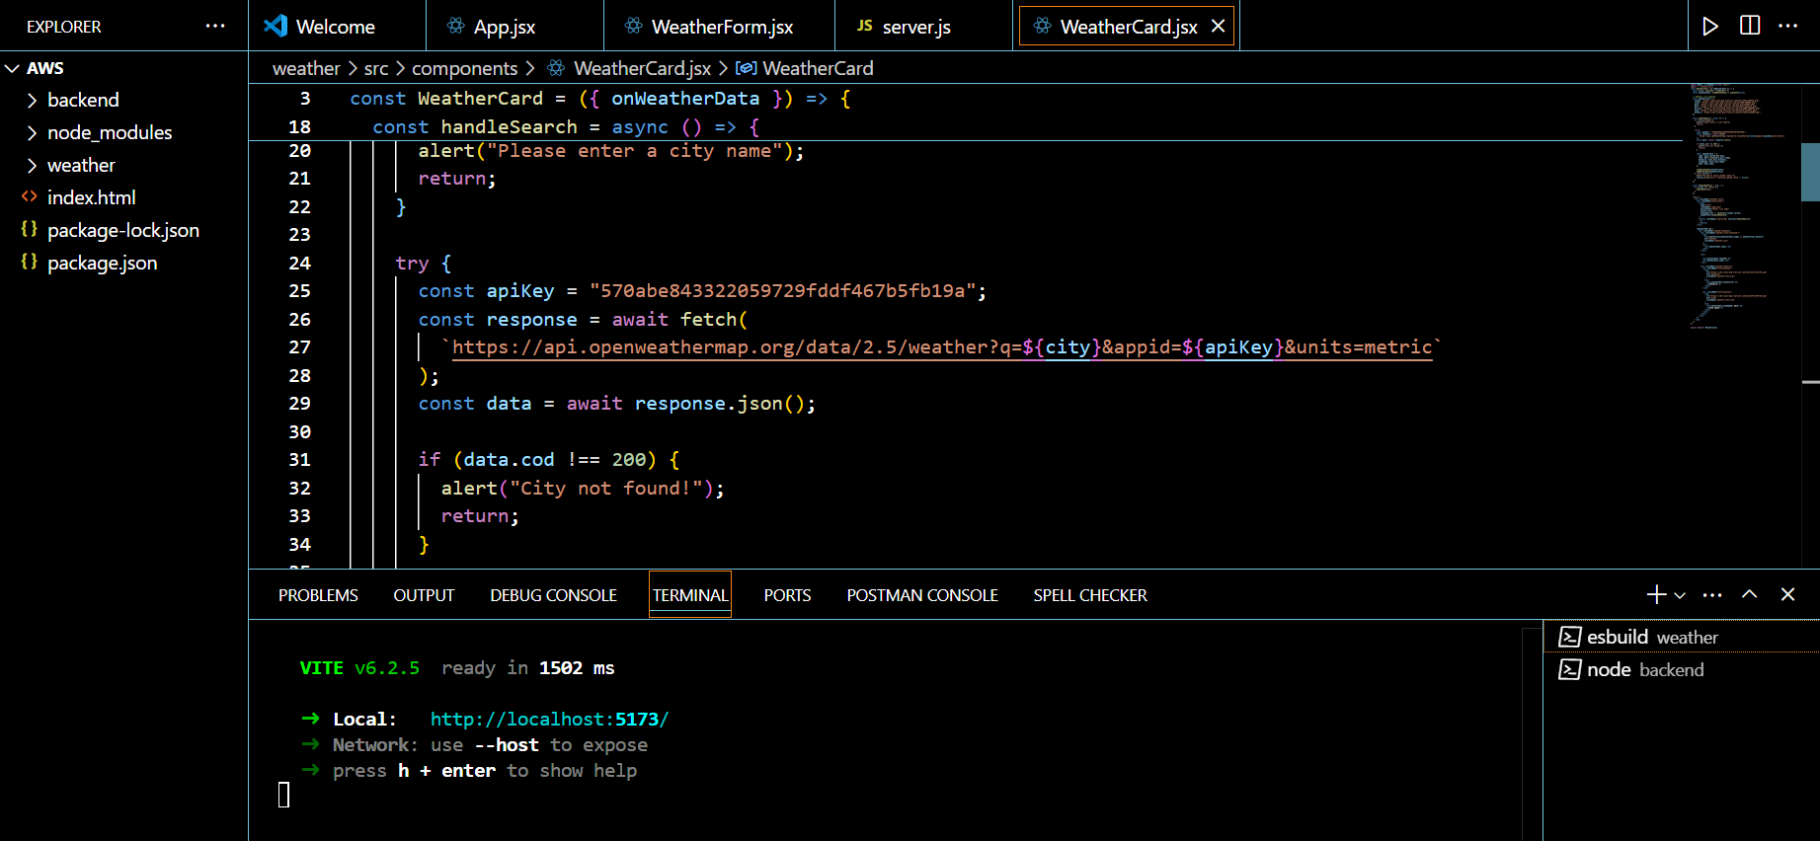
Implementation Process
Step 1: Fetch Weather Data from OpenWeatherMap API

Slide 6
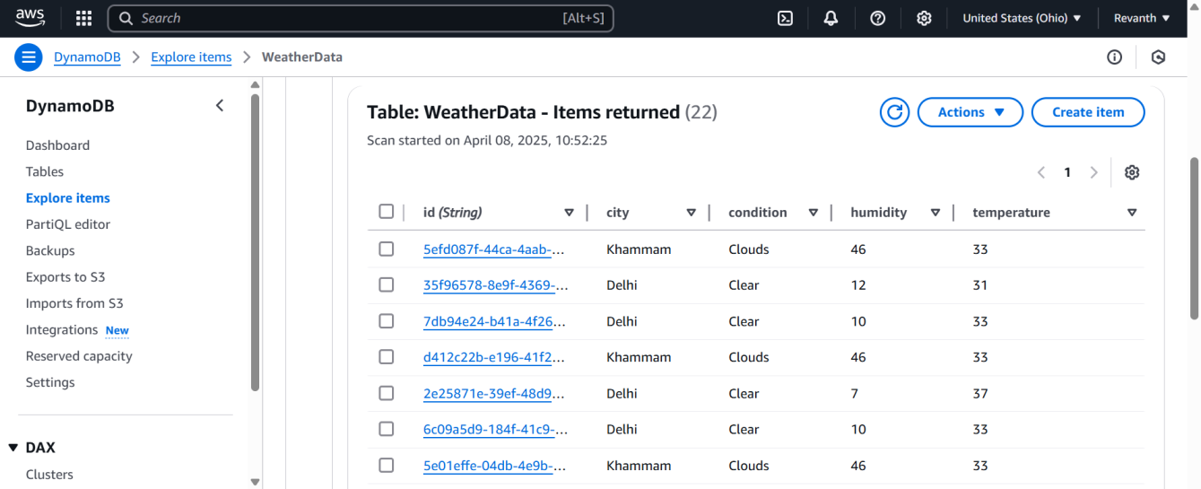
Step 2: DynamoDB Table

Slide 7
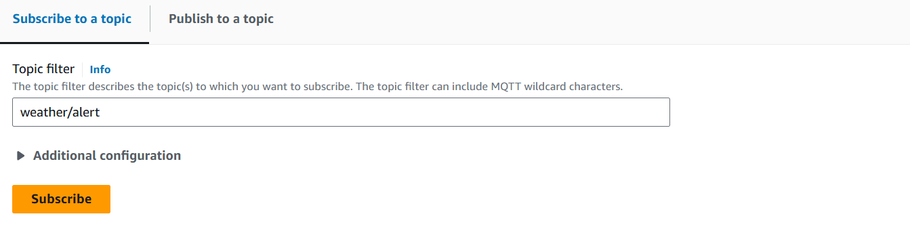
Step 3: Configure AWS IoT Core(Topic: weather/Alert)

Slide 8
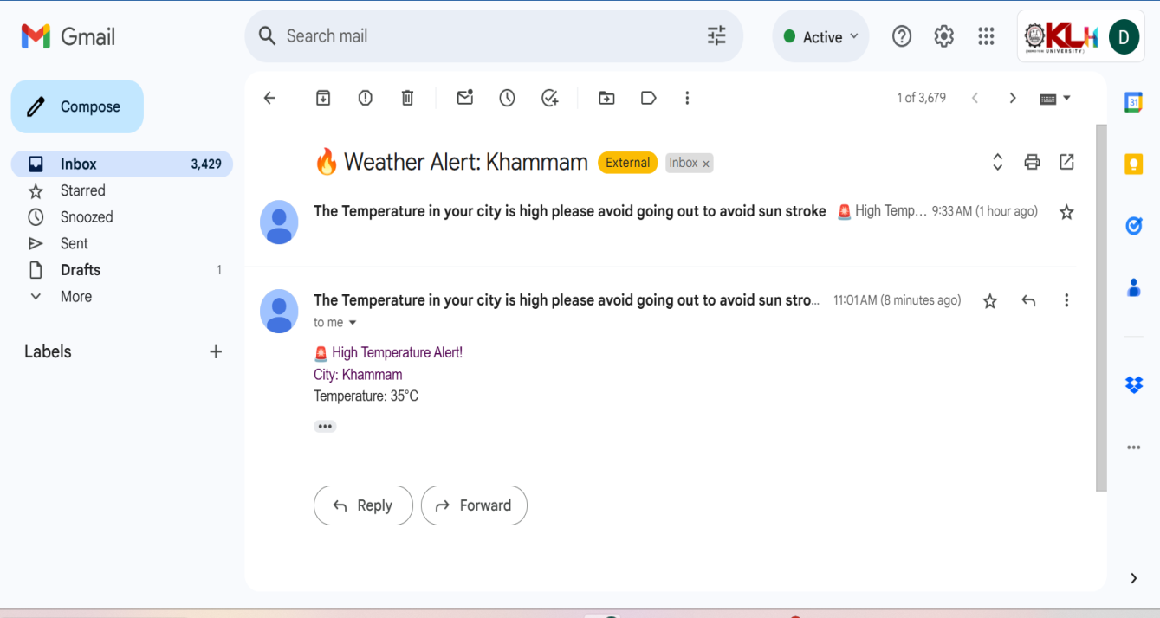
Step 4: Setup SNS Topic(Topic Name: Weatherdata ,Subscriptions: Email )

Slide 9
Key Features and Functionality
1. Real-Time Weather Data Collection
2. Data Storage with DynamoDB
3. Alerts Using AWS IoT Core
4. Temperature Notifications with SNS
5. Fully Serverless Architecture
6. Scalable and Extendable

Slide 10
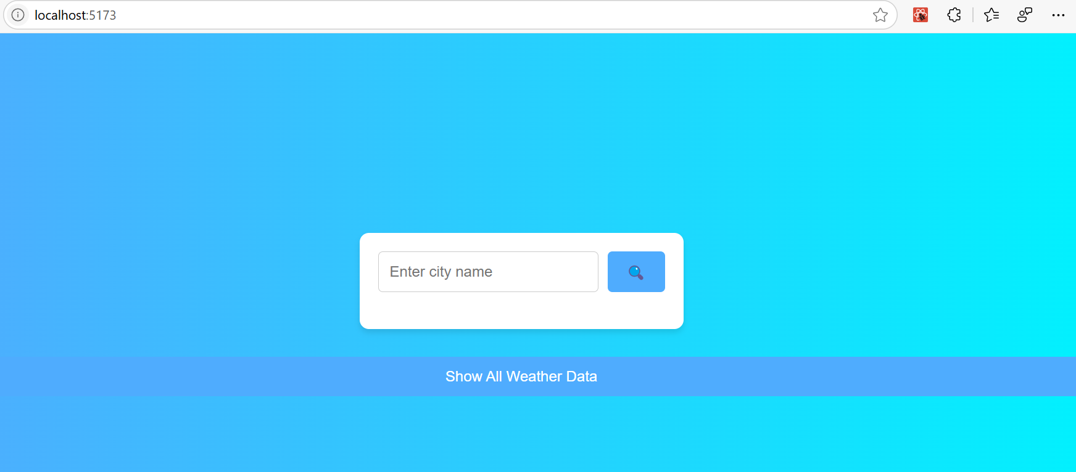
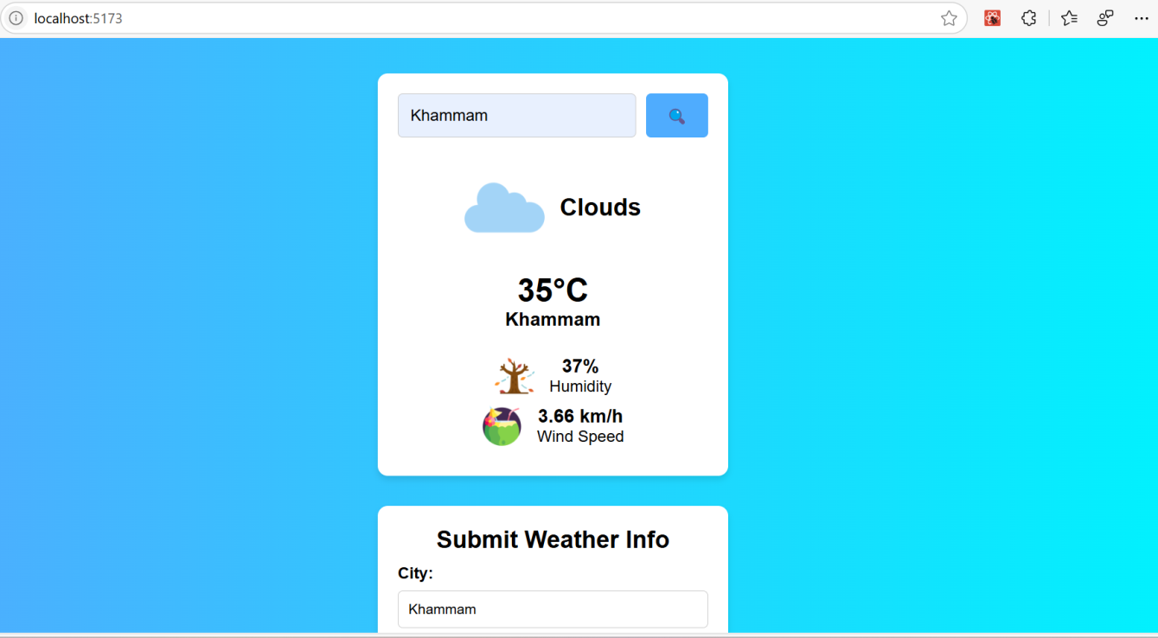
Results and Outputs

Slide 11
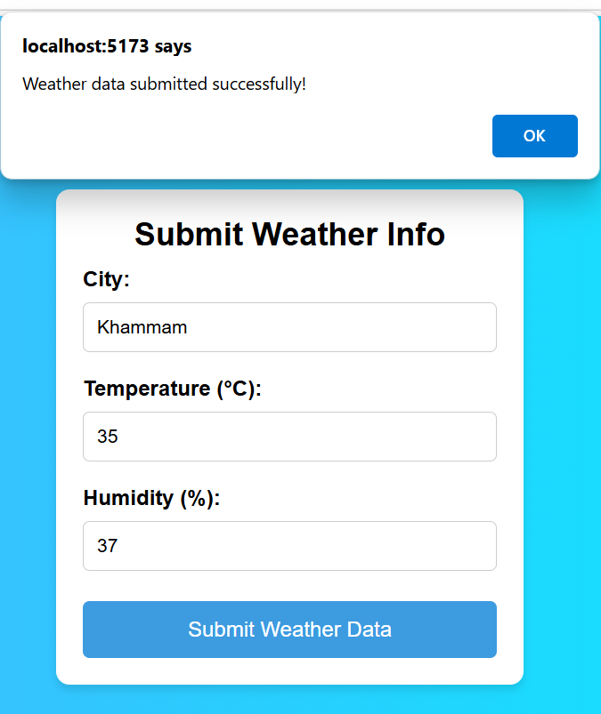

Slide 12
Challenges and Solutions
API Parsing Issue: Solved using proper JSON parsing in Lambda.
Permission Errors: Fixed by updating IAM roles for Lambda access to AWS services.
Conditional Alerts: Handled using if condition in code for temperature > 35°C.
IoT Core Not Receiving Data: Topic was incorrect → Fixed by using the exact topic name in publish command.

Slide 13
Learnings & Takeaways
Gained hands-on experience with AWS services like IoT Core, Lambda, DynamoDB, and SNS.
Learned to manage IAM roles & permissions for secure resource access.
Understood how to set up real-time data flow and cloud-based alerts.

Slide 14
Future Scope
Machine Learning Integration: Predict weather trends or extreme conditions using historical data.
Real-Time Deployment: Host on AWS using scheduled Lambda, API Gateway, and automate via Cloud Watch.
Cost Optimization: Use free-tier eligible services, reduce Lambda execution time, and enable on-demand DynamoDB.
Scalability: Use SNS topic filters, partitioned DynamoDB tables, and IoT rules for large-scale deployment.

Slide 15
References
[1] AWS Lambda Documentation – https://docs.aws.amazon.com/lambda/
[2] Amazon DynamoDB Documentation – https://docs.aws.amazon.com/dynamodb/
[3]AWS JavaScript SDK (v3) https://docs.aws.amazon.com/AWSJavaScriptSDK/v3/latest/index.html
[4] AWS IoT Core – https://aws.amazon.com/iot-core/
[5] AWS SNS (Simple Notification Service) – https://aws.amazon.com/sns/
[6] OpenWeatherMap API – https://openweathermap.org/api/
[7]AWS IoT Publishing Guide – https://docs.aws.amazon.com/iot/latest/developerguide/publishing.html
[8]AWS API Gateway Integration Settings – https://docs.aws.amazon.com/apigateway/latest/developerguide/apigateway-integration-settings-integration-type.html

Slide 16
THANK YOU

